Slide 1
Stroboscopic tweezer array heating
HT Wei

Slide 2
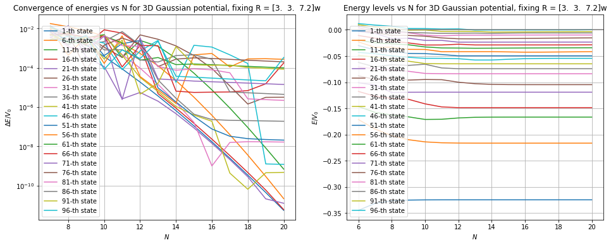
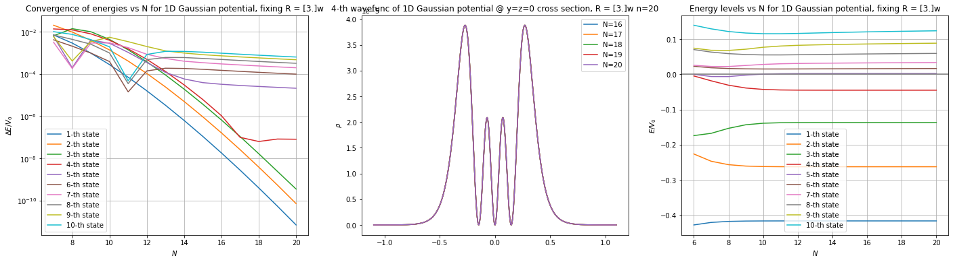

DVR grid choice
DVR energy level convergence
1D: $4$ bound states
3D: ${\sim 4}^{3}$ bound states (in fact, $～100$)
Converges well in 1D tight dimensions with half-width $R=3w$ and $N=18$ (total # of grid point being $2N+1$)
Loose dimension: $\sim 2.4×$ looser in length scale (estimated by harmonic length $0.25w$ to $0.6w$)
Full 3D: $R=\left(3, 3, 7.2\right)×w, N=(18, 18, 18)$

Slide 3
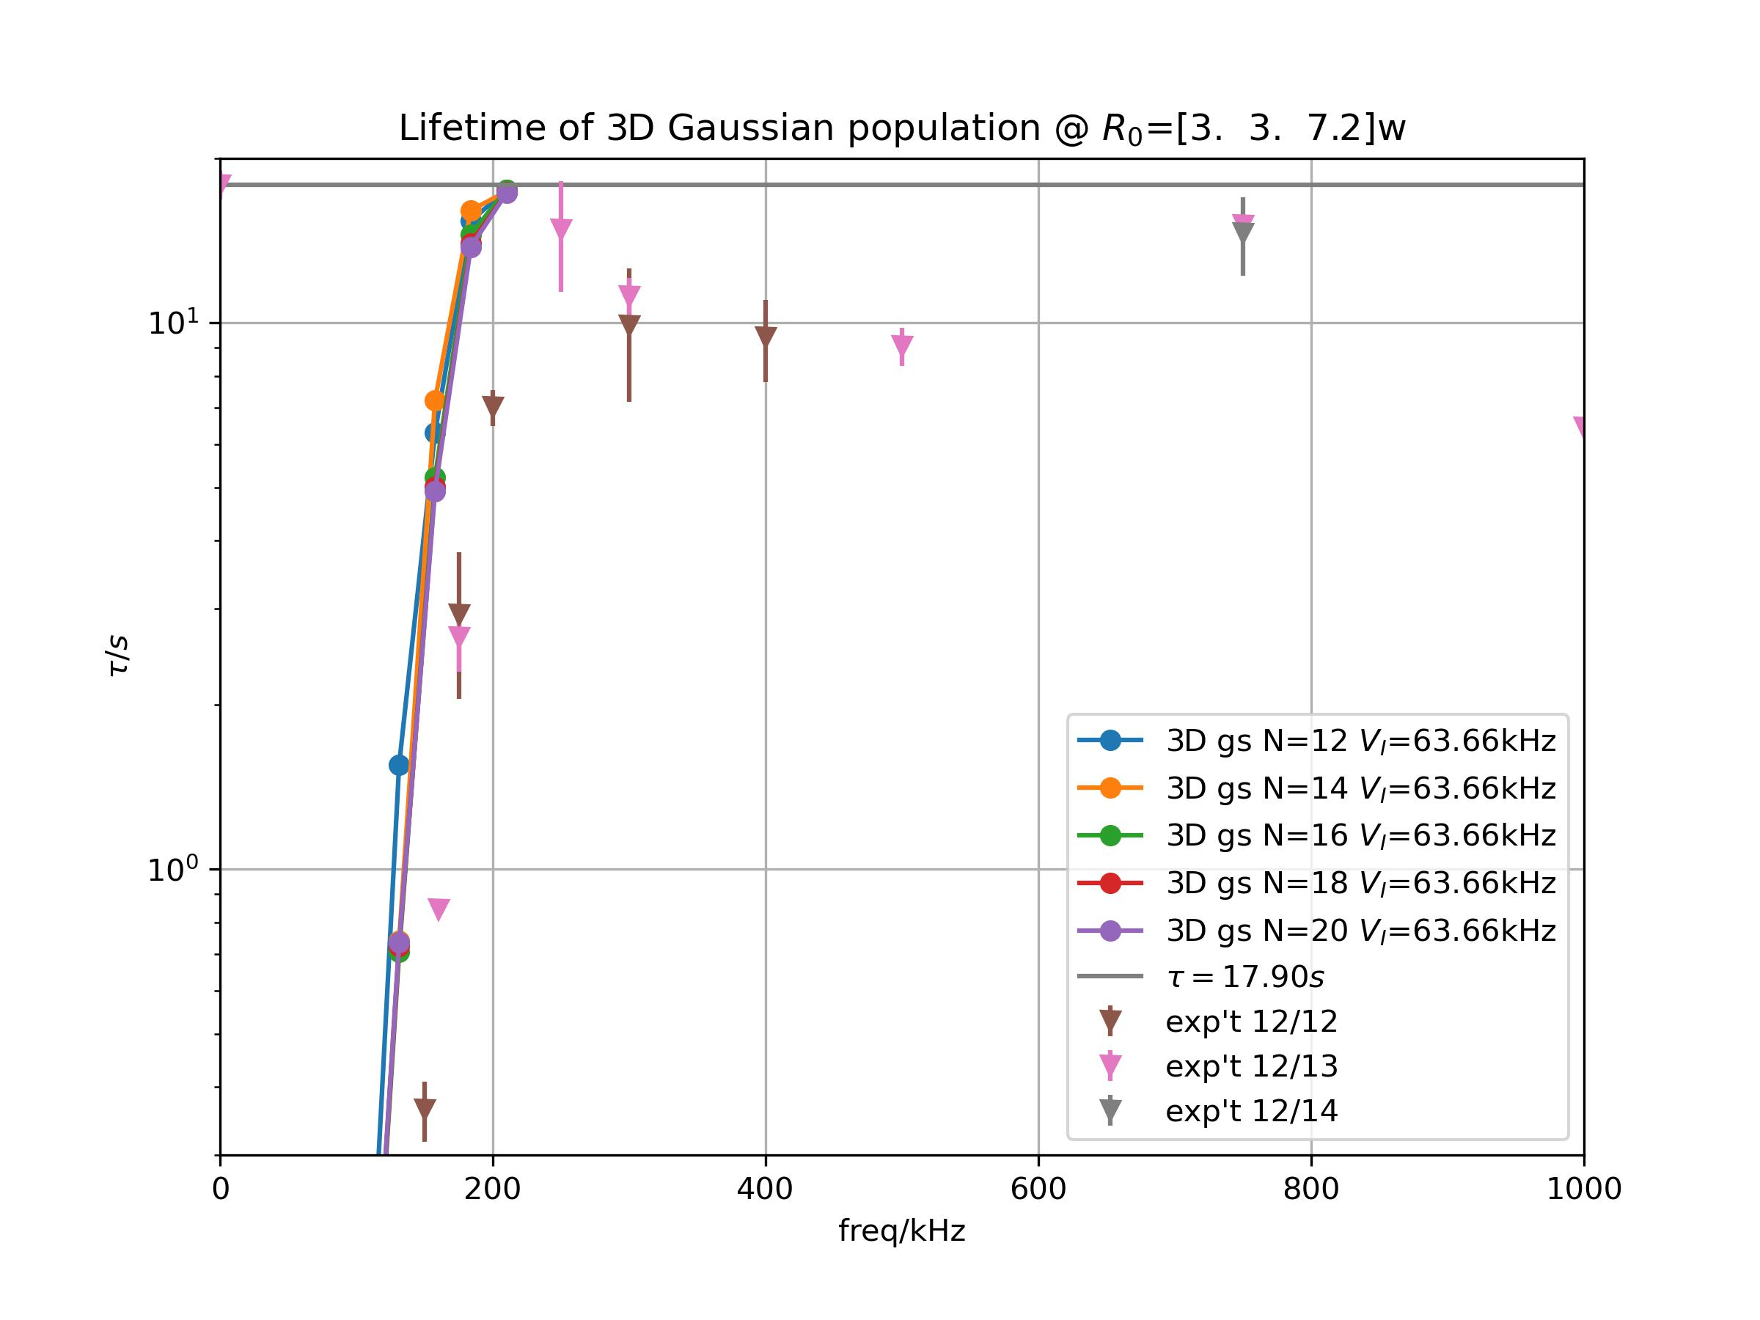

Ground state lifetime
DVR + strobe dynamics
Exp’t/numerics comparison
Effective lifetime adjusted by
$$\frac{1}{τ}=\frac{1}{τ_{s}}+\frac{1}{τ_{0}}$$
where $τ_{0}$ is lifetime of no strobe
Numerics converges with grid point number $2N+1$, but differes from exp’t values

Slide 4
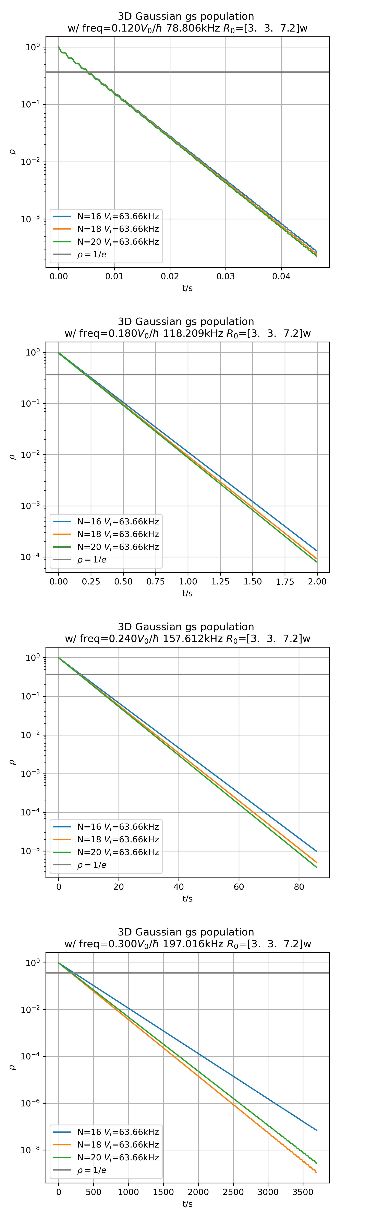

Raw data: 3D convergence
Exponential decay: semilog plot
A trend of converge with larger $N$

Slide 5
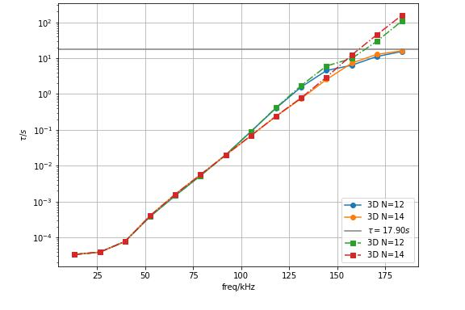
No effective correction?
The lifetime grows exponentially with strobe frequency

Slide 6
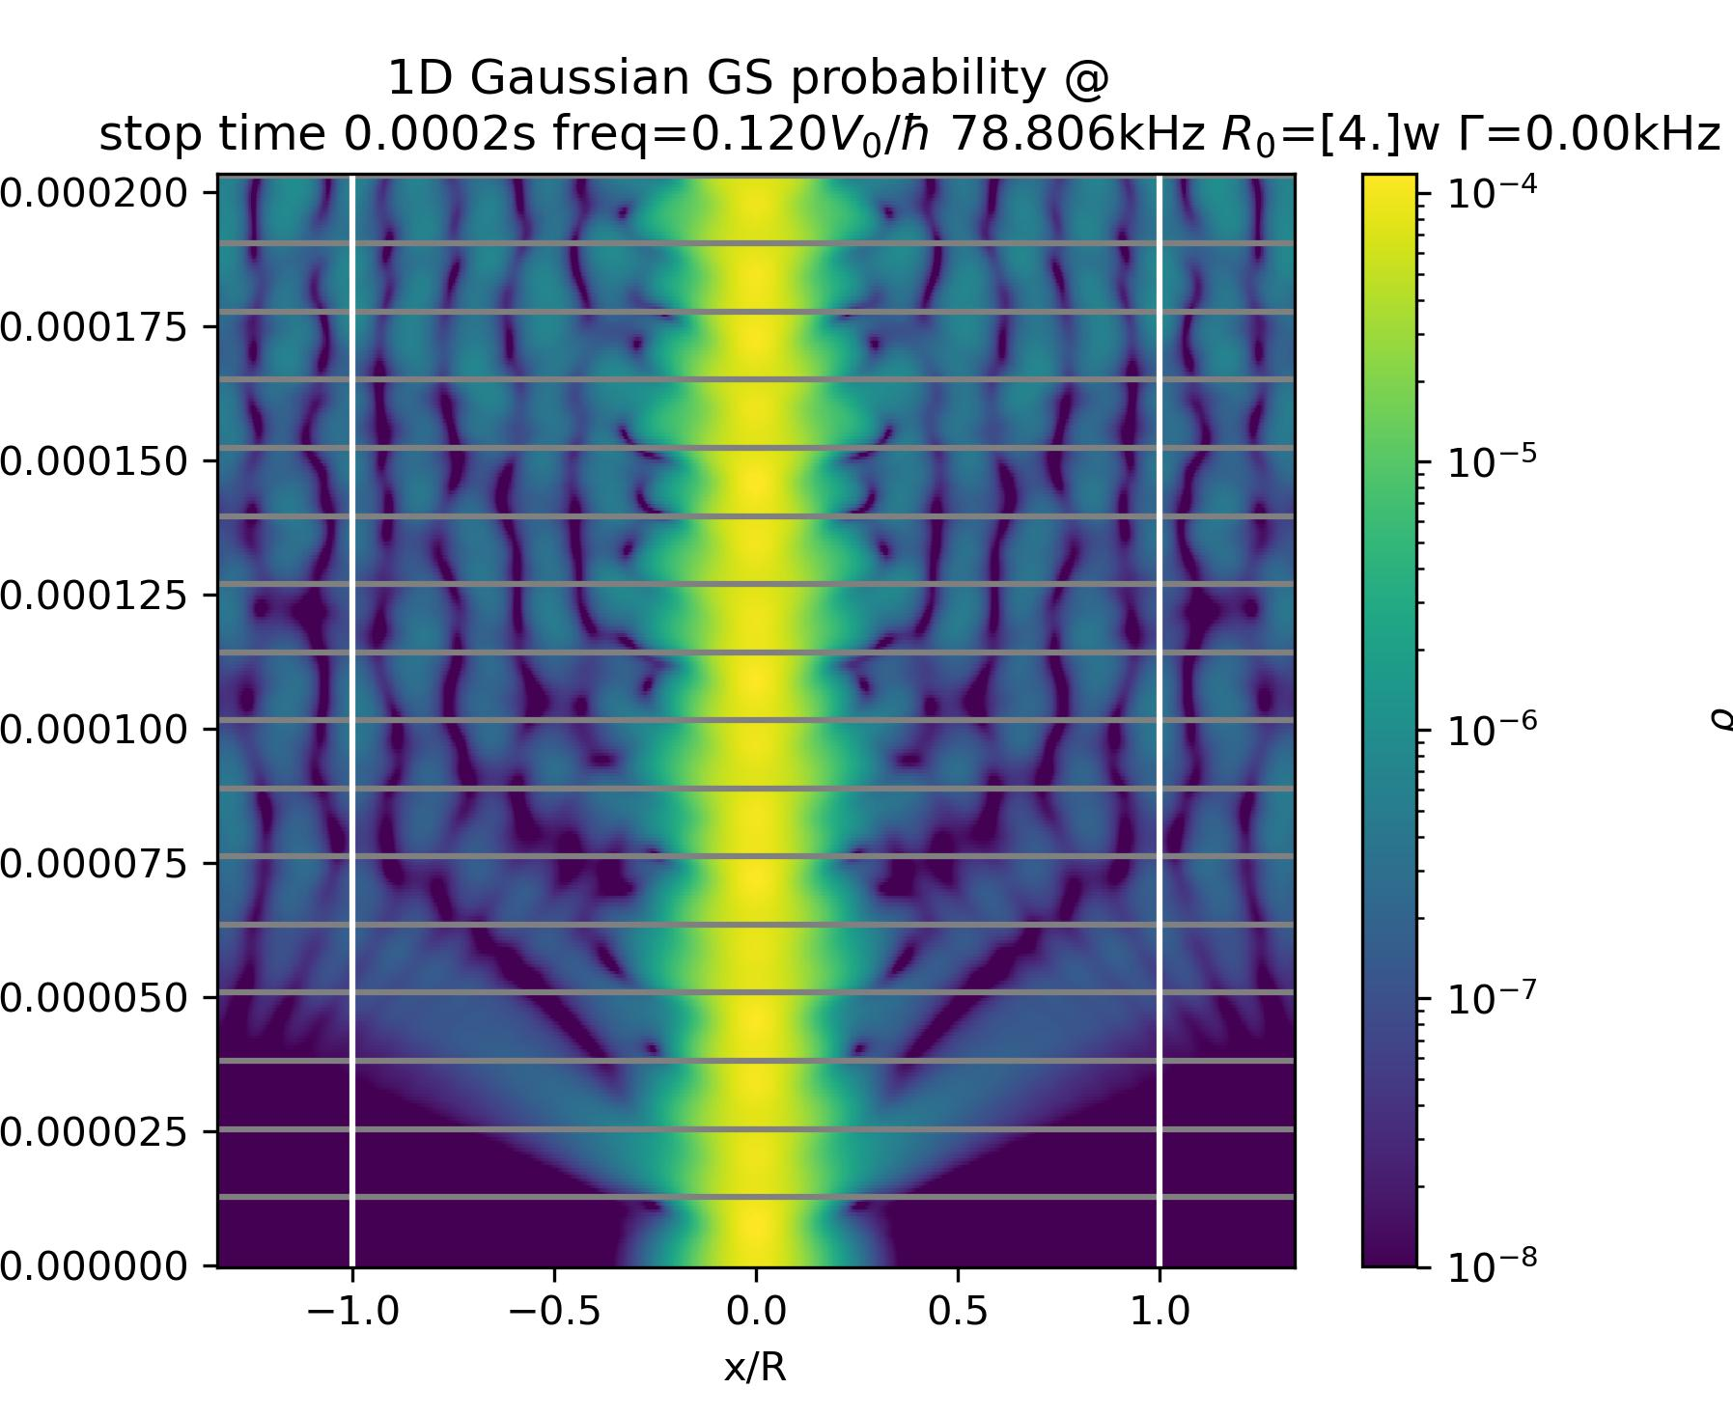
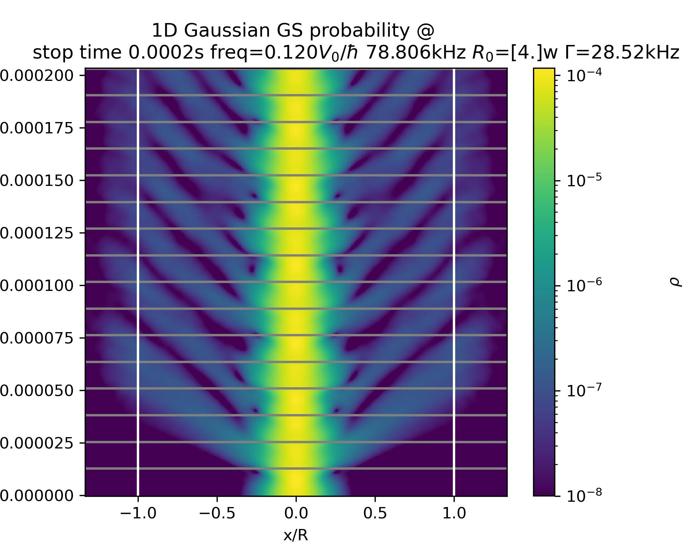

Why absorption?
Finite system: hard wall at boundaries $→$ standing wave
Actual systems: particles escape the trap
Remedy: absorption outside simulation range

Slide 7
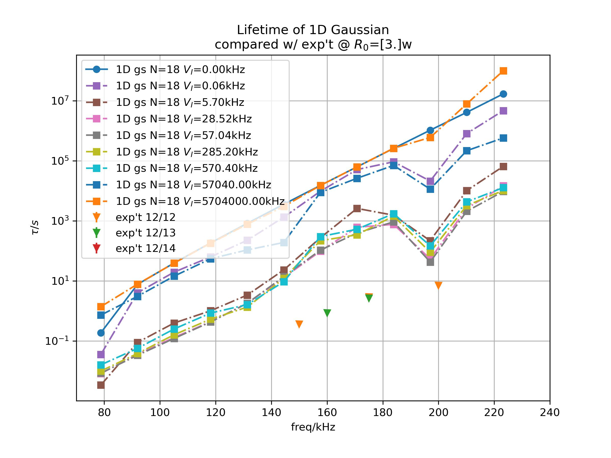
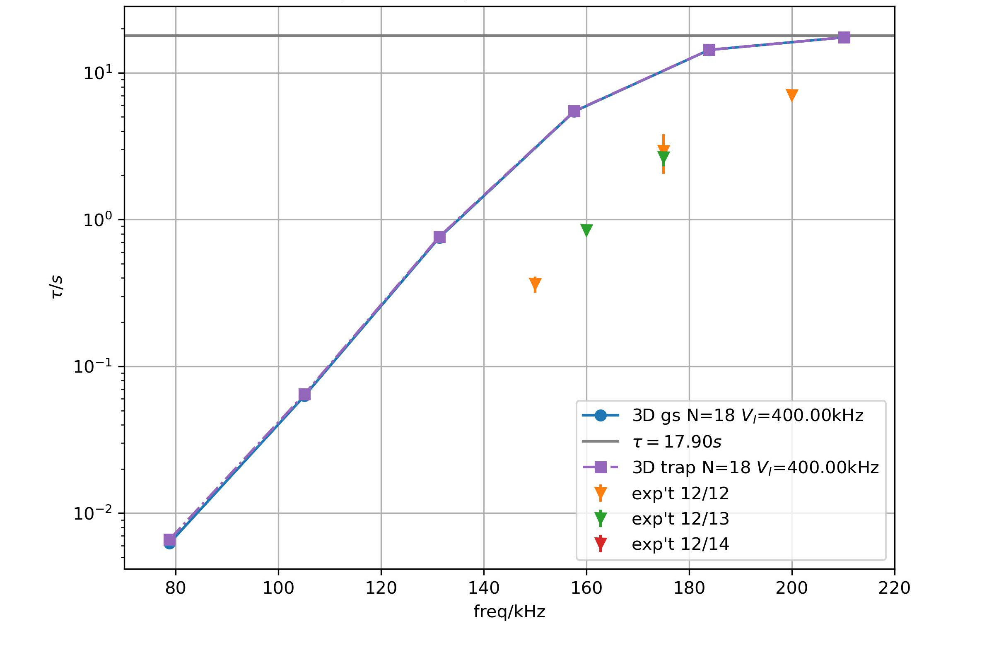

Absorption convergence
Linear absorption at boundaries
$$V_{i}(x)=−\frac{i\left(x−R\right)Γ}{L}$$
where $R$ the non-absorbing region half-width, $L$ the absorbing region width, $Γ$ the absorption strength
$Γ$ too large $→$ hard wall reflection
too small $→$ boundary reflection
Find window for $Γ$, with valid $L=w$

Slide 8
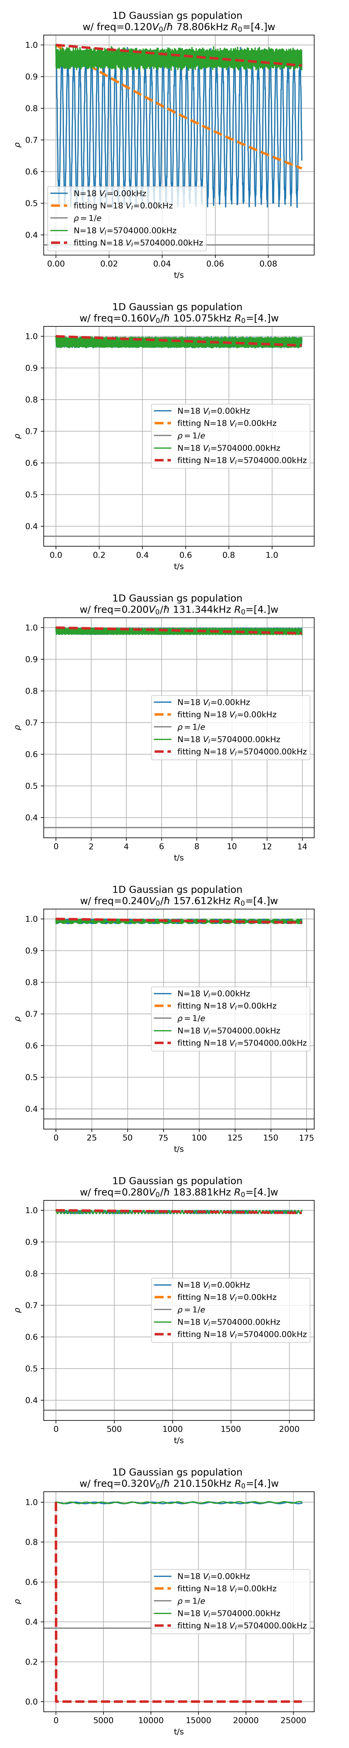
Raw data: Zeno

Slide 9
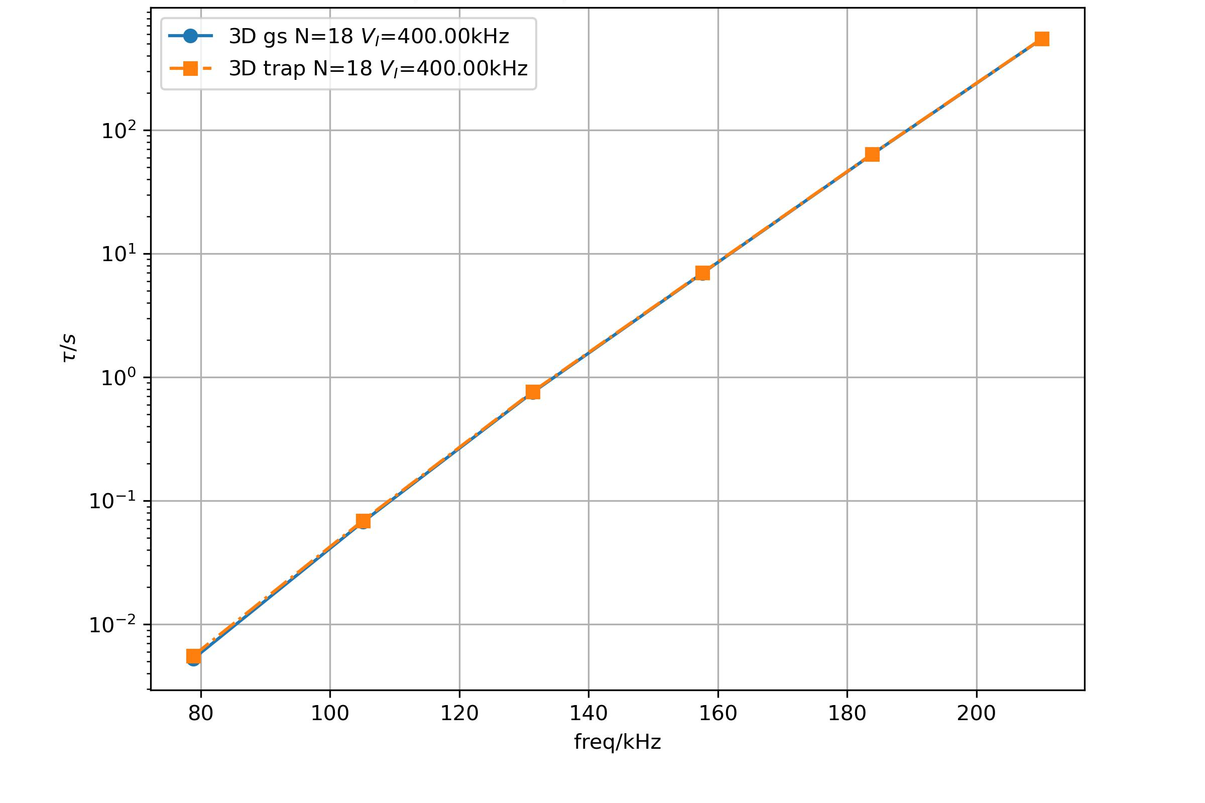
Strobe loss is mainly trap loss
GS lifetime vs trap lifetime of all bound states
GS loss = trap loss

